Slide 1

What Superintendents Need to Know Now:
School Start Window
Angel Lozano
Strategic Data Performance Coach

Slide 2





























Clear Brook
Versus
Dickinson
Summer Creek
Versus
Channelview
Eisenhower
Versus
Davis
Milby
Versus
Galena Park
Friday
9/27/24
Klein Oak
Versus
Klein Forest
Santa Fe
Versus
FB Marshall
Spring
Versus
Westfield
Baytown Lee
Versus
Texas City
La Porte
Versus
Friendswood
Hargrave
Versus
Liberty
Tarkington
Versus
Crockett
Hempstead
Versus
Thorndale
South Houston
Versus
Alvin
Alief Hastings
Versus
Alief Elsik
Notes:
These are games that will occur on Friday, September 27 2024 – the last Friday in September which is also the school start window

Slide 3
What To Know:
School Start Window
Timeframe
Compliance and Accuracy
Leaver Codes and Underreported Students
Data Reporting Requirements
Impact on Accountability
Last Friday in September
Report key enrollment statuses, leaver codes, and other essential data
Verifying accurate and complete data
Identify students previously enrolled who did not return.
Enter appropriate leaver codes to avoid underreported
Encourage continuers to re-enroll
Data can influence graduation rates, dropout rates, data validation reporting

Slide 4
Each student served in a district in one school year must be accounted for the next fall through the TEA or district records.
A continuer is a student who at the end of their expected graduation year has not graduated and is enrolled by the school start window. These students are not considered dropouts because they continue their education beyond the traditional four-year graduation timeline.
A student will appear on a district’s Underreported Student listing if a leaver record was not submitted for a student served by the district the prior year who did not return by the end of the school start window the following year and did not:
Enroll in another Texas public school
Receive a Texas Certificate of High School Equivalency (TxCHSE) by August 31.
Previously graduated from a Texas public school, or
A leaver code should be entered by the close of the school start window if a student does not return or does not enroll in another Texas public school.
Status | Definition | Included in longitudinal rates?
Graduated | Graduated by August 31, 2024 (including IGC graduate coding) | Yes
Continuer | Enrolled by September 27, 2024ª | Yes
TxCHSE recipient | Received TxCHSE by August 31, 2024 | Yes
Dropout | Dropped Out | Yes
Other leaver | Left for reasons other than graduating or dropping out (i.e. homeschool, private school, etc.) | No
Underreported | No record received (record not reported by school start window) | No
Student ID error | Cannot track student from year to year because of errors in identification information | No
ªThe school-start window ends the last Friday in September.

Slide 5
Timeline of Student Leaver Verification
Student enrolls
Prior Year
Student leaves
Prior Year
First day of school (current year)
Cumulative enrollment event (UID)
School Start Window opens
2nd Friday in September
Close of School Start Window
Last Friday in September
Fall Snapshot
Last Friday in October
December -Underreported student list available
Fall submission due to TEA
Fall resubmission due to TEA
January
No-shows identified
Students who did not show up on the first day of school

Slide 6
Graduation Rates and Accountability
Student Achievement Domain
STAAR Performance
College, Career, and Military Readiness
Graduation Rates
School Progress Domain
Part A: Academic Growth
Part B: Relative Performance
Closing the Gaps
Academic Achievement
English Language Proficiency
Results-Driven Accountability
Bilingual/ESL
Other Student Populations
Special Education
College, Career and Military Readiness
Graduation Rates
Graduation rates are included in the A—F accountability system and the Results-Driven Accountability System.
The Student Achievement Domain uses the best of the four-year, five-year, or six-year state graduation rate.
The Closing the Gaps Domain uses the four-year federal graduation rate.
The four-year federal graduation rate is evaluated in RDA.
The annual dropout rate (7-12) is also evaluated in RDA for each program.

Slide 7
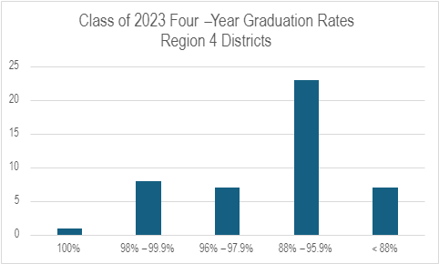
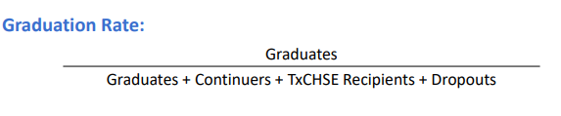
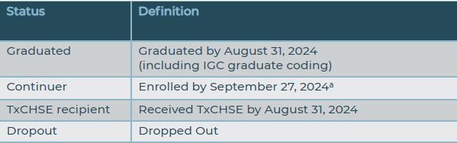
Region 4 by the Numbers: Graduation Rate
The longitudinal graduation rate includes the percentage of graduates in a class (cohort).
Region 4
89.6%
State
90.3%
Notes:
Can this just be by LEA and not charters?

Slide 8
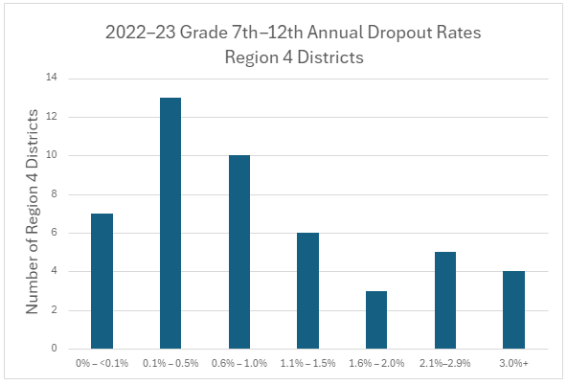

Region 4 by the Numbers
The annual dropout rate is the percentage of students who drop out of school during one school year.
There are three annual dropout rates:
Grades 7—8
Grades 9—12
Grades 7—12
Region 4
2.1%
State
2.0%
Notes:
Can we do a table with only districts and 7-12 annual dropout rates? Do we have the four-year dropout rates?

Slide 9
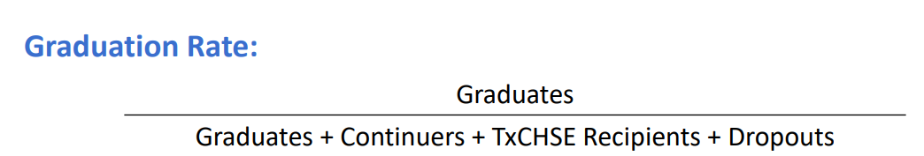
2023 Graduation
Status | Definition | Included in longitudinal rates?
Graduated | Graduated by August 31, 2023 | Yes
Continuer | Enrolled by September 29, 2023ª | Yes
TxCHSE recipient | Received TxCHSE by August 31, 2023 | Yes
Dropout | Dropped Out | Yes
Other leaver | Left for reasons other than graduating or dropping out (i.e. homeschool, private school, etc.) | No
Underreported | No record received (record not reported by school start window) | No
Student ID error | Cannot track student from year to year because of errors in identification information | No
ªThe school-start window ends the last Friday in September.
Class
Cohort

Slide 10

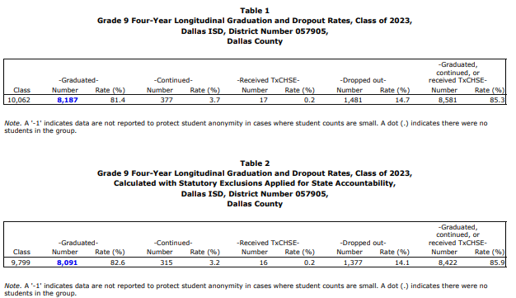
Four-Year Federal
Federal Rate
Closing the Gaps And RDA
State Rate
Student Achievement
(Best of four-year, five-year, or six-year)
TEA Graduation Completion Data​

Slide 11
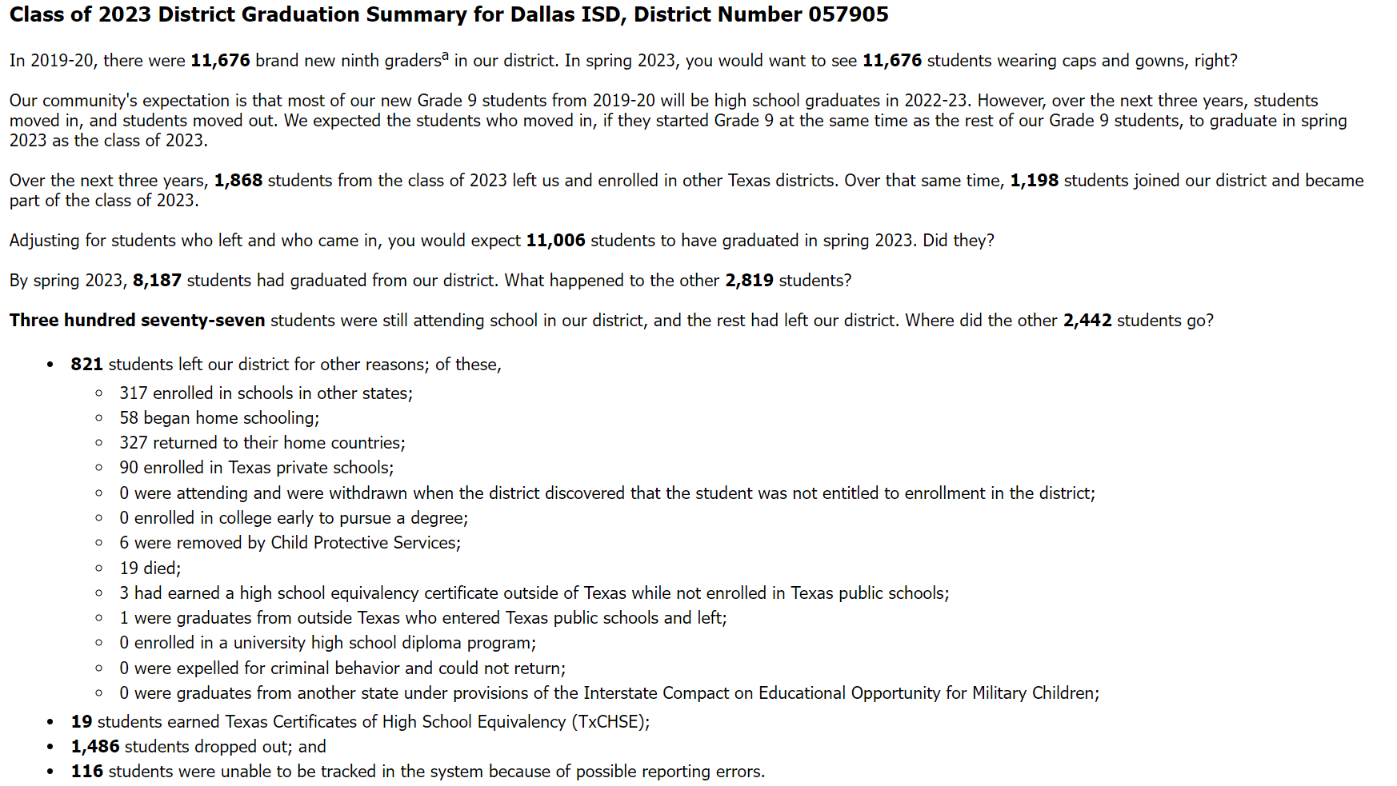
Graduation Summary
These students are in the class and cohort
These students are in the cohort

Slide 12
State Individual Graduation Committee (IGC) Rates

Slide 13
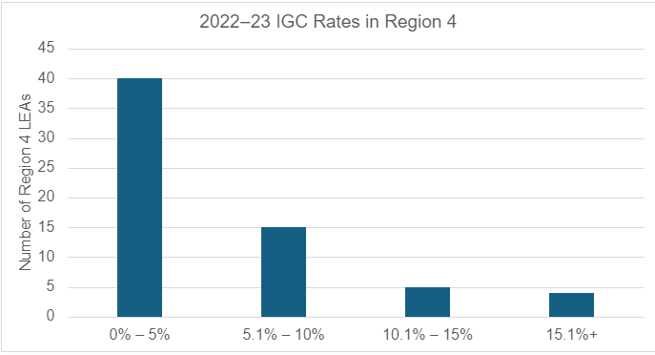
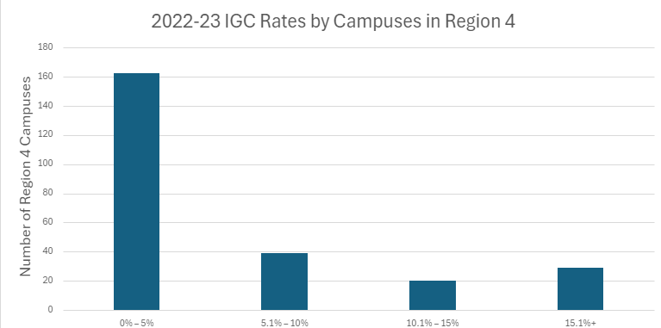
Region 4 by the Numbers: IGC
Region 4
5.4%
State
4.4%

Slide 14
Individual Graduation Committee
Consider implementing IGC best practices
If not in compliance, TEA recommends implementing any corrective actions or improvements to current IGC policies or procedures for the 2024-2025 school year.
SDRU will continue to issue compliance reviews related to IGCs with the expectation that all LEAs will be in compliance by the start of the 2024-2025 school year.
Texas Education Code §29.003(a)(15), permits the commissioner to authorize a special investigation to be conducted when 10 percent or more of the students graduating in a particular school year from a particular high school campus are awarded a diploma based on the determination of an individual graduation committee.
If a campus is identified as not following IGC requirements and is graduating students who have not met graduation requirements, these data could also impact the state accountability system (TEC §39.003(a)(14)).

Slide 15
Thank you!
Angel Lozano
Strategic Data Performance Coach
Texas Strategic Leadership
Angel.Lozano@esc4.net | 713.744.6596

